Slide 1
What needs fixing in the way the finance sector communicates?
To what extent are regulatory requirements a barrier to effective comms?
Is it true that regulatory requirements are sometimes used as an unjustified excuse for poor comms? – is there a tendency to “hide behind the lawyers?”
Is the use of impenetrable language ever acceptable? If not, why does it sometimes get used?
What can be done for communication to lead to better engagement?
Communicating investment costs and performance figures are particular challenges; what’s the latest thinking of the best way to do it in a compliant yet effective manner?
In the ESG space, is “Greenwash” as big an issue as some say; if so, what should be done about it?
How mindful should comms professionals be of the key learnings from the world of behavioural finance?
What’s it going to take for the finance industry to communicate with integrity, credibility and authenticity?
What changes would we want policymakers and regulators to make to help advance the cause for better and more authentic comms?
What might be the benefits of developing a set of protocols, or guiding principles, or Best Practice Guide that could be adopted by the sector, on a voluntary basis?
Could such an idea develop into some kind of “Comms kite mark” for the finance industry; whereby comms that meet agreed criteria are acknowledged in some way

Slide 2
When assessing whether a promotion is fair, clear and not misleading, a firm may need to consider (among other things):
The authenticity of the proposition described in the relevant promotion. This may mean undertaking background checks on directors, controllers or other key individuals associated with the product provider.
The commercial viability of the proposition described in the promotion. Has the promotion adequately disclosed any significant factors that could threaten the product’s viability? Could potential investors make an informed decision about investment?
Whether advertised or headline rates of return are reasonably capable of being achieved. This may mean reviewing materials such as the product provider’s financial statements and/or management accounts, business plan, financial projections and capital position.
Whether there are any fees, commissions or other charges within the investment’s structure or elsewhere that could materially affect the ability of the product provider to deliver advertised or headline rates of return.
If the product is advertised as being eligible for a particular tax treatment (eg, for inclusion within an Innovative Finance ISA), does the product actually meet the requirements for this treatment? (For tax treatment, see also COBS 4.5.7 R; COBS 4.5A.8 UK)

Slide 3
In assessing whether a financial promotion is fair, clear and not misleading, a firm should consider the guidance in COBS 4. In particular, firms are reminded that COBS 4.2.5 G states that ‘a financial promotion should not describe a feature of a product or service as ‘guaranteed’, ‘protected’ or ‘secure’, or use a similar term unless:
that term is capable of being a fair, clear and not misleading description of it, and
the firm communicates all of the information necessary, and presents that information with sufficient clarity and prominence, to make the use of that term fair, clear and not misleading.
This means that where an investment is described in a promotion as ‘secured’ or ‘asset-backed’ (or equivalent), you should consider whether the promotion contains the information necessary to enable investors to:
understand how such protection operates, and
• assess any potential weaknesses or deficiencies in it
MECHANISMS PROTECTIONS RISKS

Slide 4
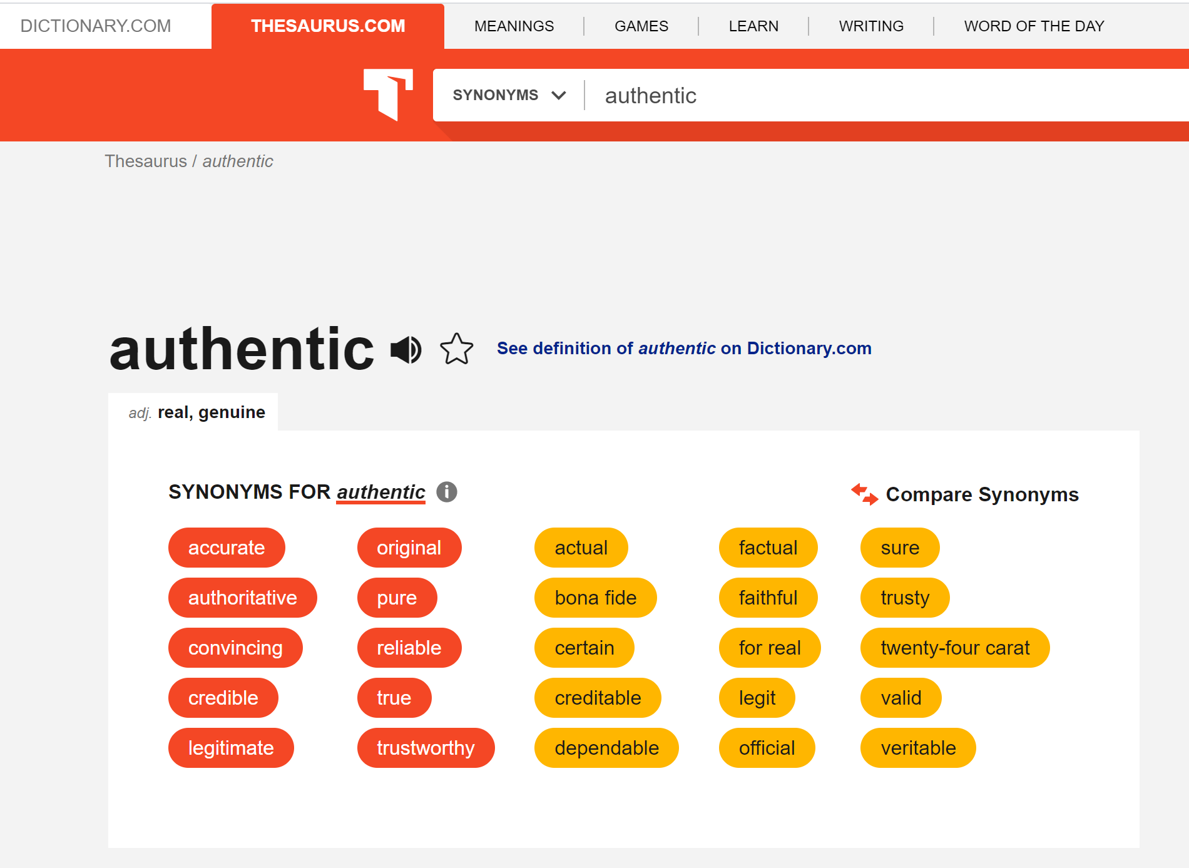

Slide 5
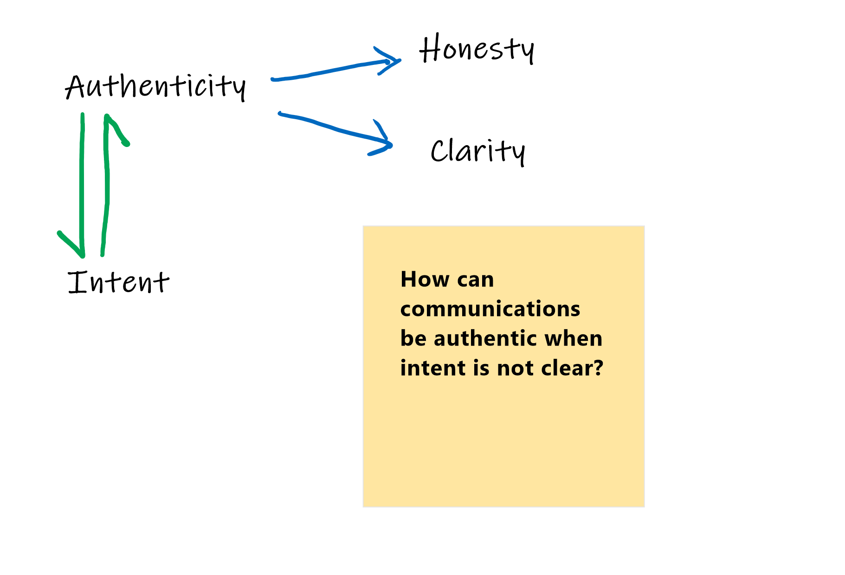

Slide 6
The road to hell is paved with good intentions...
Continuous loop of communication
Listen
Ownership – mistakes happen, admit them, own
Adjust
Improve
Rinse repeat….

